Slide 1
Visitor Pattern

Slide 2
Visitor Pattern
Use a visitor class which changes the executing algorithm of an element class.
This pattern comes under behavior pattern category.

Slide 3
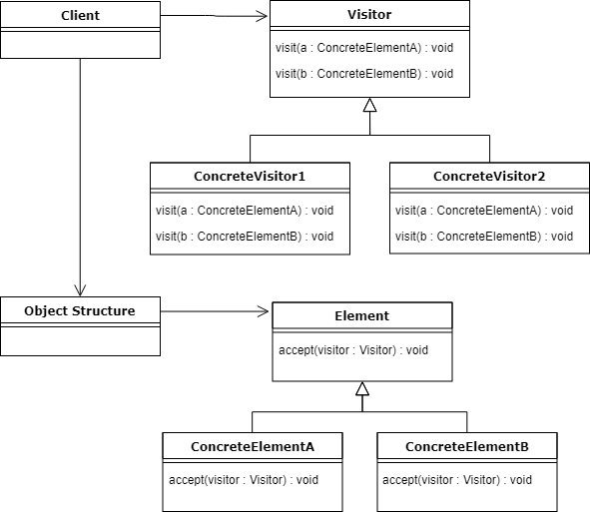
Visitor Pattern

Slide 4
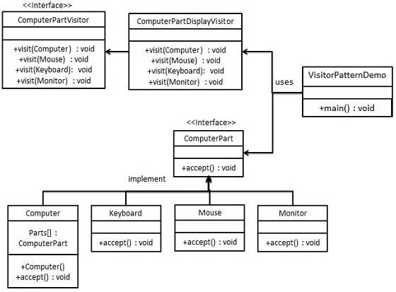
Visitor Pattern

Slide 5
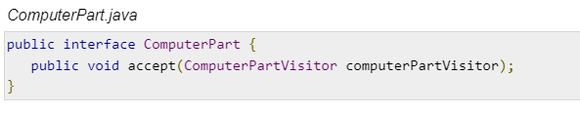
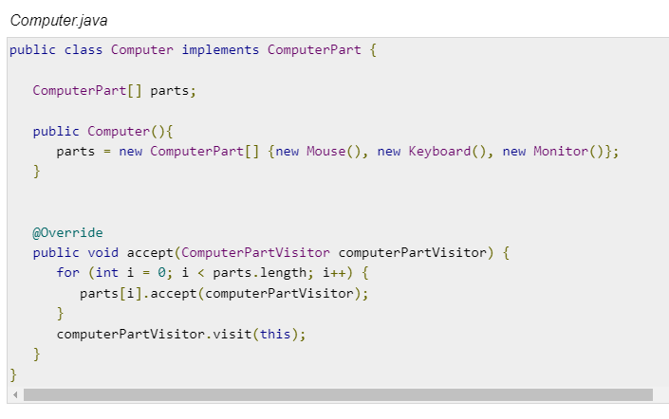
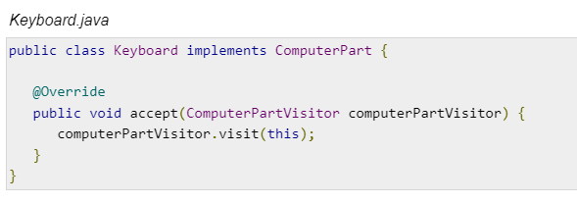
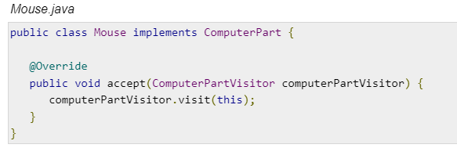
Visitor Pattern

Slide 6
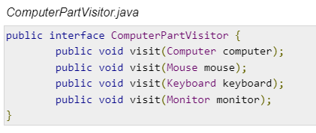
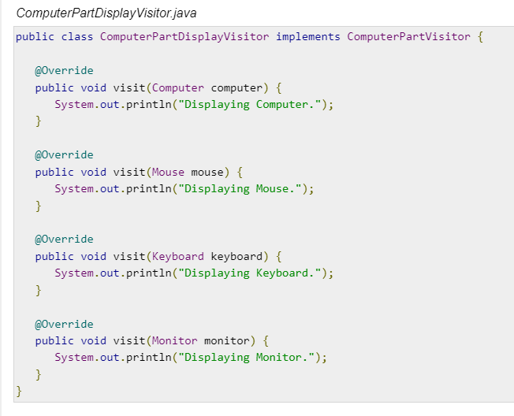
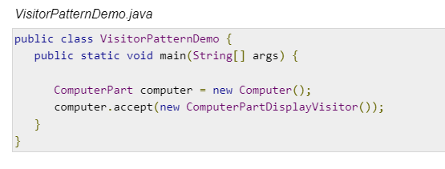
Visitor Pattern

Slide 7
Visitor Pattern
Difference between strategy and Visitor?
Learn the concept “Double Dispatch”.
How visitor pattern is related to Composite?

